Slide 1


Social Dynamics in Patent Examination
Zhicheng Zhong
Tashfeen Ahmed
Jingwen He
Xinran Yu

Slide 2

Table of contents
01
Dataset Overview
& Methodology
02
EDA
03
Model Analysis
04
Conclusion

Slide 3


01
Dataset Overview & Methodology

Slide 4

Dataset Overview: USPTO + Advice Network
1537478 rows x 16 columns
dropped rows where columns used for inference has null values
gender = babyname(examiner_first_name)
ethnicity =rethnicity (examiner_family_name)
tenure days = max(appl_status_date) - min(filing_date)
patent processing time = patent_issue_date/abandon_date - filing_date
USPTO
32906 rows x 4 columns (dropped 843 rows where ego = alter)
application_number : corresponds to column of same in USPTO
ego_examiner_id: can be used as a key to join on examiner_id from USPTO
alter_examiner_id: can be used as a key to join on examiner_id from USPTO
We extract a unqiue examiner attributes table (gender, race, tenure days) from USPTO dataset and join it to the network dataset on both the ego and alter examiner id for network visualization
Advice Network

Slide 5
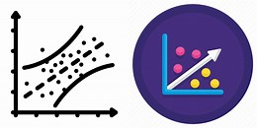

Methodology: Sampling, Regression and Machine Learning
process time = intercept + b1*social +b2*demography+b3*orginization+b4*interactions
social factors such as centralities (degree, betweenness)
demographic factors such as gender and race
organizational factors such as technology center
interaction terms to control for factors such as gender and ethnicity
Linear Regression
Good at catching the non-linearity
computationally and time consuming
Down-sampled 153 million records to 50000 records
Interpretation of results by reading feature importance
Random Forest

Slide 6
02
EDA

Slide 7
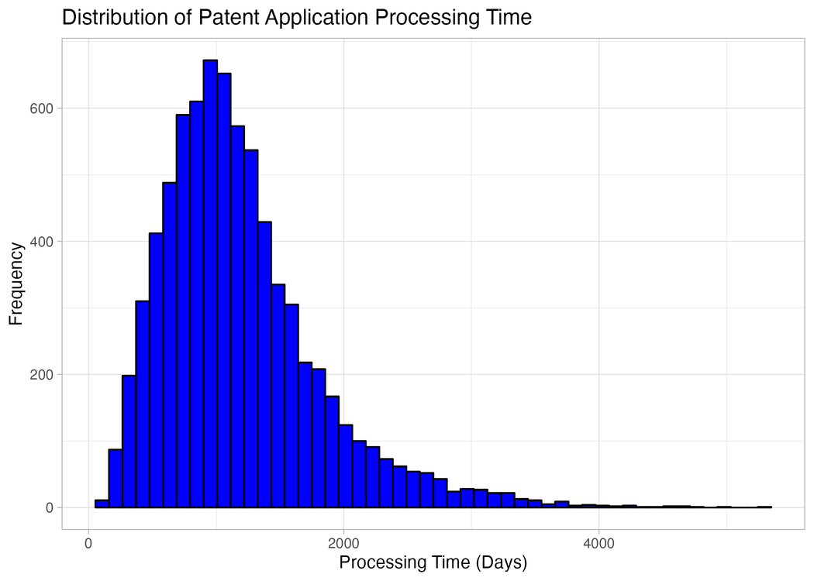
EDA: Application Processing Time
Typical processing time for a patent application is around 1000 days.
A long tail in the histogram shows that some applications take significantly longer to process.
The distribution is right-skewed, indicating faster processing for the majority of applications.
Outliers are evident and should be excluded for a more accurate analysis.

Slide 8
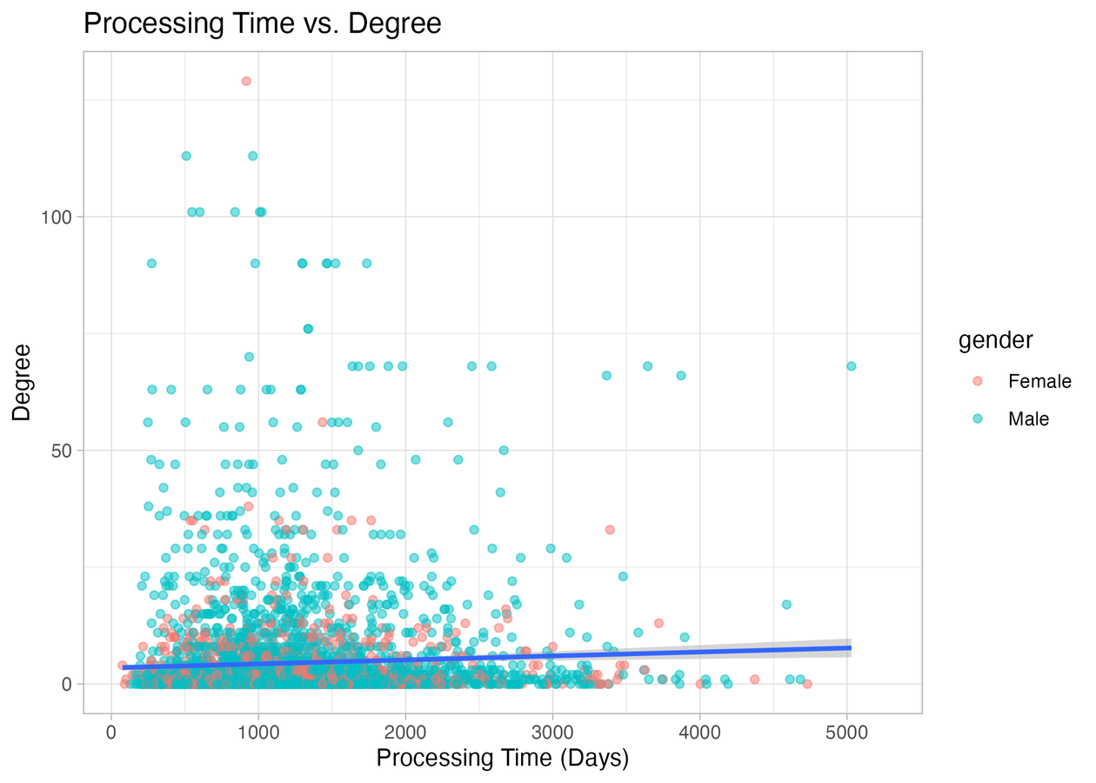
EDA: Application Processing Time vs Degree Centrality
Scatter plot shows a subtle upward trend.
As the degree of interaction between examiners increases, the processing time tends to rise.
This trend is consistent across both genders, suggesting a potential impact of network dynamics on efficiency.

Slide 9
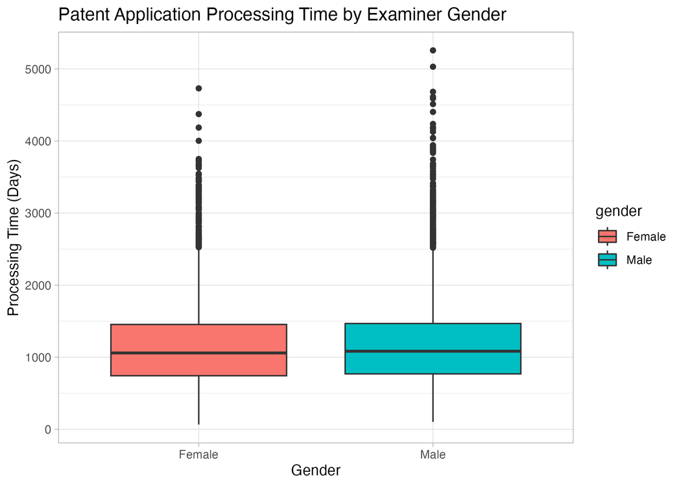
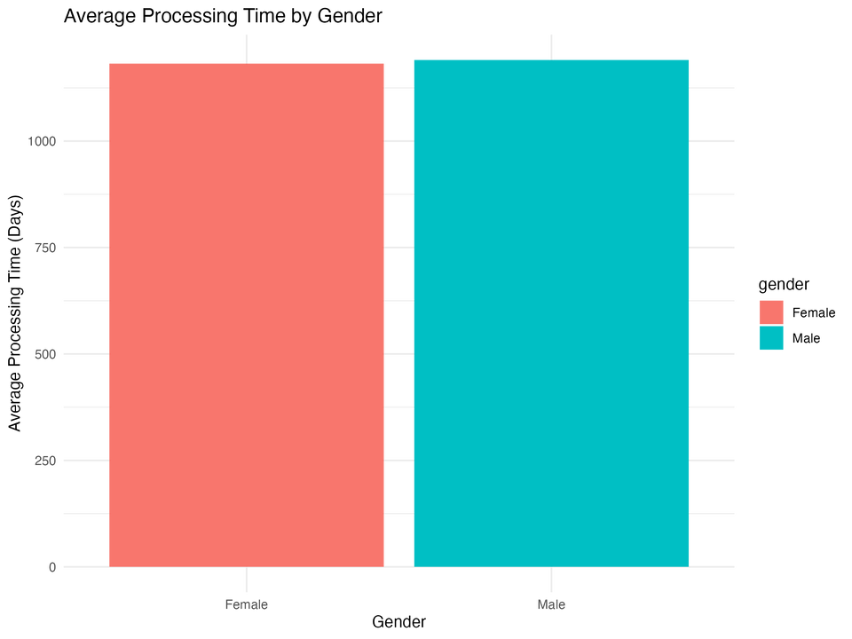
EDA: Gender Analysis in Processing Time
Both genders show a similar average processing time for patent applications, approximately 1,000 days.

Slide 10
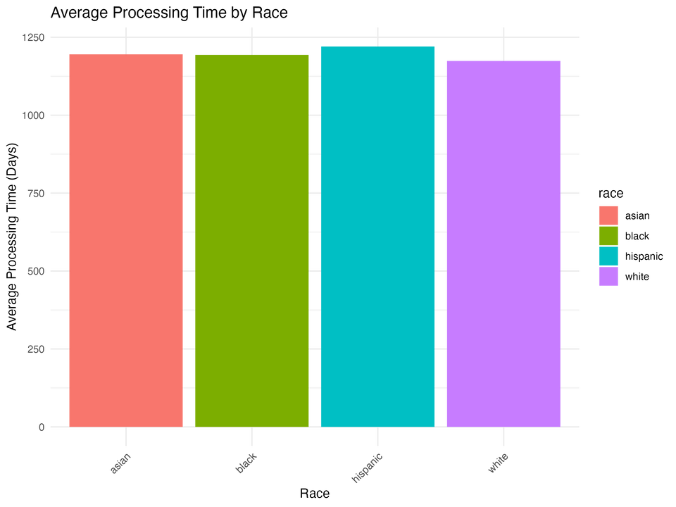
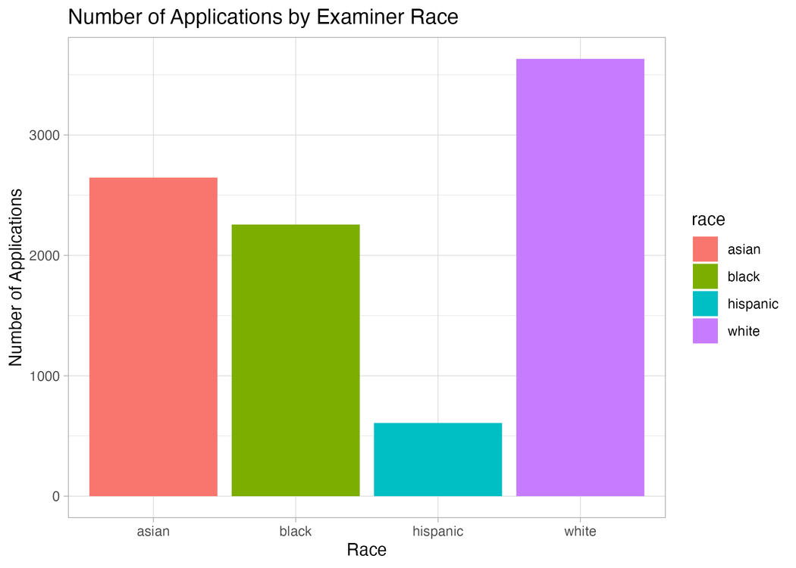
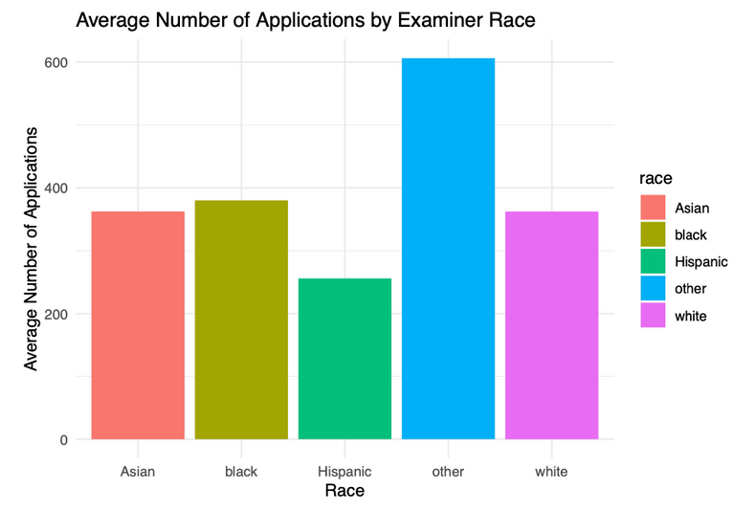
EDA: Racial Analysis in Processing Time and Workload
All races have a similar average processing time of approximately 1250 days for patent applications, indicating equitable treatment in processing times.
White examiners have processed the most applications overall.
Despite the disparity in total applications processed, the average number of applications processed per race is consistent, suggesting a fair distribution of workload.

Slide 11
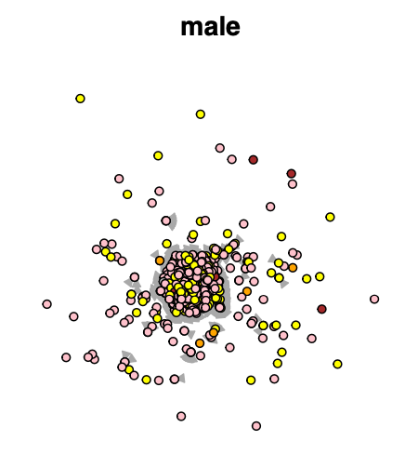
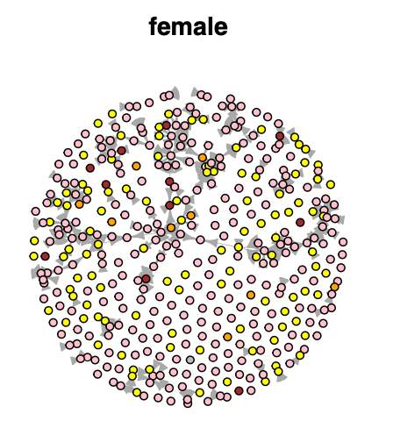
EDA: Gender Network Graph
Male Examiners:
Exhibit a centralized network with dense clustering.
High degree of interaction is particularly noted among Asian and White males.
Indicates strong intra-group communication within these racial categories.
Female Examiners:
Networks are generally more dispersed compared to males.
Notable clustering is observed among White and Asian females.
Suggests areas of focused communication but less centralized than their male counterparts.

Slide 12
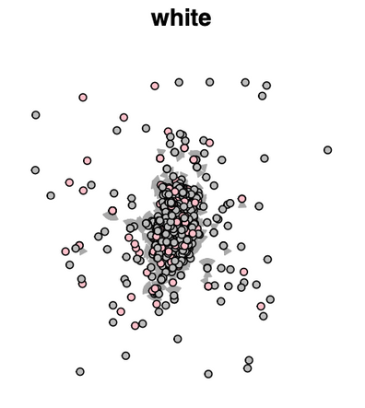
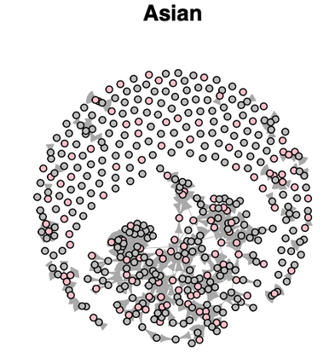
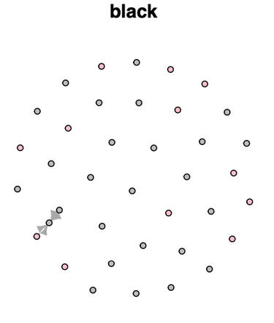
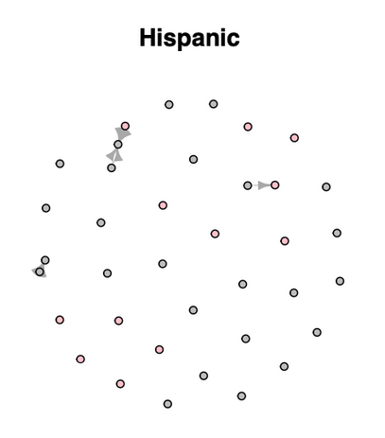
EDA: Race Network Graph
White Examiners:
High level of interaction with central clustering in the network graph.
Indicates a strong community bond or centralized influence among White examiners.
Asian Examiners:
Numerous interlinking connections, with more single nodes than White
Suggests a broad and evenly distributed pattern of communication, reflecting active involvement across the group.
Black and Hispanic Examiners:
Scattered nodes with minimal clustering
Indicates more isolated interactions and lower engagement in collective discussions among these groups.

Slide 13
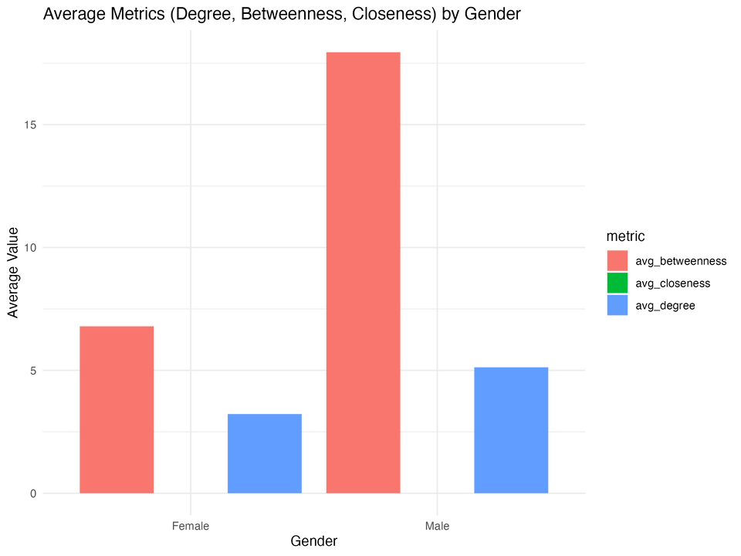
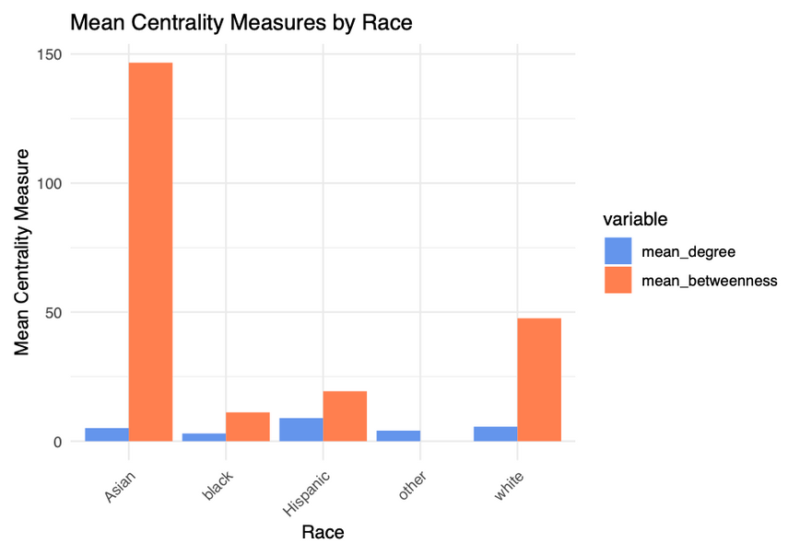
EDA: Gender, Race and Centrality Measures
Mean degree centrality is comparable for both male and female examiners, indicating equal levels of engagement in information sharing within the organization.
Males have a higher betweenness centrality, suggesting a critical role in facilitating information transfer across different clusters of the network.
Asian examiners exhibit the highest betweenness centrality, indicating a pivotal role in information transfer across different clusters, followed by White examiners.
Hispanics show slightly higher degree centrality, suggesting their active engagement in interactions within the network.

Slide 14
03
Model Analysis

Slide 15
Variable | Estimate | Std. Error | t-value | P-value
(Intercept) | 1009.5562 | 1.6959 | 595.291 | <2e-16
log_degree | 25.40401 | 1.59915 | 15.886 | <2e-16
log_betweenness | 12.72942 | 1.46346 | 8.698 | <2e-16
gendermale | -6.3593 | 1.21307 | -5.242 | 1.59E-07
raceblack | 11.23396 | 3.85076 | 2.917 | 0.00353
raceHispanic | 1.13986 | 4.26892 | 0.267 | 0.789459
raceother | 134.31215 | 13.94044 | 9.635 | <2e-16
racewhite | -12.72897 | 1.32165 | -9.631 | <2e-16
tenure_days | -8.35162 | 1.34475 | -6.211 | 5.28E-10
tc1700 | 22.9081 | 1.42356 | 16.092 | <2e-16
tc2100 | 169.04821 | 1.71483 | 98.58 | <2e-16
tc2400 | 95.73142 | 1.98808 | 48.153 | <2e-16
log_degree:gendermale | -4.96 | 1.33244 | -3.722 | 0.000197
log_betweenness:gendermale | 2.73935 | 1.34479 | 2.037 | 0.041649
gendermale:tenure_days | -0.06023 | 1.27766 | -0.047 | 0.962404
log_degree:raceblack | -11.77472 | 4.62745 | -2.545 | 0.010942
log_degree:raceHispanic | -25.95658 | 4.21688 | -6.155 | 7.49E-10
log_degree:raceother | -90.99896 | 14.55167 | -6.254 | 4.02E-10
log_degree:racewhite | -10.70987 | 1.42758 | -7.502 | 6.29E-14
log_betweenness:raceblack | 2.14462 | 5.66081 | 0.379 | 0.704796
log_betweenness:raceHispanic | 21.44965 | 4.89239 | 4.384 | 1.16E-05
log_betweenness:racewhite | -12.05342 | 1.25049 | -9.639 | <2e-16
raceblack:tenure_days | -42.02431 | 5.17635 | -8.119 | 4.73E-16
raceHispanic:tenure_days | 1.16061 | 5.0203 | 0.231 | 0.817173
racewhite:tenure_days | -14.46995 | 1.21934 | -11.867 | <2e-16
Linear Regression Results

Slide 16
Linear Regression Analysis Result
Data Preprocessing: Logarithmic transformation to normalizes distributions, while standardization of numerical variables ensures equitable contribution and comparability across the model
Key Variables and Their Impact on Patent Processing Time
Baseline Processing Time (Intercept): High baseline time, significant when other variables are zero.
Examiner Network Connectivity:
log_degree: Positive coefficient; higher connectivity increases processing time.
log_betweenness: Positive coefficient; key communicators face longer times.
Demographic Factors:
gendermale: Negative coefficient; male examiners have slightly shorter processing times than female.
raceblack: Positive coefficient; associated with slightly longer processing times vs Asian baseline.
raceHispanic: Positive but not significant; unclear impact on processing time.
racewhite: Negative coefficient; slightly shorter processing times vs Asian baseline.
Examiner Experience:
tenure_days: Negative coefficient; more experience leads to faster processing time.
Technology Center Impact
tc1700, tc2100, tc2400: All positive coefficients; notably higher in tc2100, indicating longer processing times in these technology centers.
Interaction Effects
log_degree:gendermale: Negative; slight reduced impact of connectivity for male examiners than female.
log_betweenness:gendermale: Slight positive increase in processing times for males with high betweenness.
gendermale:tenure_days: Not significant; tenure impact consistent across genders

Slide 17
Linear Regression Analysis Result
Racial and Connectivity Interactions
log_degree and race interactions:
log_degree:raceblack, raceHispanic, raceother, racewhite: These terms all have negative coefficients, suggesting while increased network connectivity generally leads to longer patent processing times, its impact is mitigated for examiners of these racial groups compared to the baseline (Asian)
log_betweenness and race interactions:
Significant increase in processing times for raceHispanic and slight for raceBlack; opposite trend for racewhite compared to Asian.
Tenure and Race Interaction
raceblack:tenure_days, raceHispanic:tenure_days, racewhite:tenure_days:
raceblack and racewhite: Negative coefficients; tenure significantly reduces processing time, more pronounced for white examiners.
raceHispanic: slightly postive coefficient but statistically insignidicant
Statistically Insignificant Variables
Variables: raceHispanic, gendermale:tenure_days, log_betweenness:raceblack, raceHispanic:tenure_days.
High p-values; changes in these variables do not significantly affect processing times

Slide 18
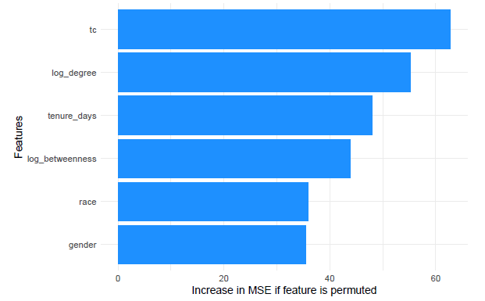
Random Forest Feature Importance
Overview of Key Predictors of Patent Processing Times
Technology Center (tc):
Most significant predictor of processing times.
Indicates variations in process efficiency, case complexity, and resource allocation across centers.
Network Position and Connectivity:
log_betweenness: Importance of an examiner’s central role in the advice-sharing network.
log_degree: Impact of the number of connections on processing times.
Examiners with higher network metrics may handle more complex applications or play crucial roles in examination processes.
Tenure (tenure_days):
Experienced examiners significantly influence processing times.
Indicates improved efficiency and familiarity with the patent process due to longer tenure.
Feature Importance
Gender and Race:
These characteristics have a measurable but less pronounced effect on processing times compared to organizational factors.
Still contribute to variations in how patents are processed.

Slide 19
04
Conclusion

Slide 20




Key Findings
Technology centers :specific technology center handling the patent application is the most significant predictor of processing time
Tenure and experience more experienced examiners have a notable impact on prosecution times (more experience leads to lower processing times), potentially due to better familiarity with the patent process or greater efficiency in handling applications
Patent Processing Time: patent processing time is right-skewed and has outliers which are removed
Gender and Processing Time: There is no significant difference in processing times between genders, with both showing a mean of approximately 1000 days. Linear regression shows a slightly lower processing time for male
Race and Processing Time: Processing times are consistent across races with a mean around 1250 days, indicating no racial bias in processing times, though white examiners have processed the most applications. Linear regression shows slightly variance in processing times for different races and specific interaction effects which are marginal

Slide 21

Business Insights
Enhance Training and Development:Tailored training that speeds up the familiarity with patent processes can be particularly beneficial
Optimize Operations: Address inefficiencies in technology centers with longer processing times through resource reallocation or process reengineering.
Optimize Network Efficiency: Aim to evenly distribute network engagement among USPTO examiners, manage collaborative loads effectively using streamlined tools and protocols that prevent over-reliance on specific key individuals for information, and provide targeted support to high-centrality examiners to prevent bottlenecks and enhance overall organizational productivity
Address Demographic Disparities: Implementing diversity and inclusion training to mitigate any unconscious bias and ensuring equitable work distribution among examiners could improve fairness and efficiency
Strengthen Examiner Collaboration and Mentorship: Promoting a culture of collaboration and mentorship, especially between new and experienced examiners

Slide 22

Future Study
Longitudinal Study: To further enhance our understanding, it's recommended to incorporate a longitudinal perspective to observe evolving relationships over time
Impact of Policy Shifts: Examining changes in USPTO policies or demographics could provide deeper insights into the social dynamics affecting patent examination processes
Enhanced Predictive Accuracy: Understanding temporal changes can improve predictions of processing times
Equity and Efficiency: Insights gained can help create a more equitable and efficient patent system

Slide 23
Thanks for watching!

